Slide 1


Objectives
In this session, you will learn to:
  Manipulate the components of a Web page

Slide 2
Working with Browser Objects
The navigator object:
  Is an independent object with its own set of properties and methods.
  Is used to access information about the current browser.
  Provides the following properties:
  Provides the following methods:
appName
appVersion
appCodeName
userAgent
platform
javaEnabled()
taintEnabled()
Notes:
x

Slide 3
Working with Browser Objects (Contd.)
The screen object:
  Enables you to access details of the user’s screen, such as its width and height.
  Provides the following properties:
height
pixelDepth
width
availHeight
availWidth
colorDepth
Notes:
x

Slide 4
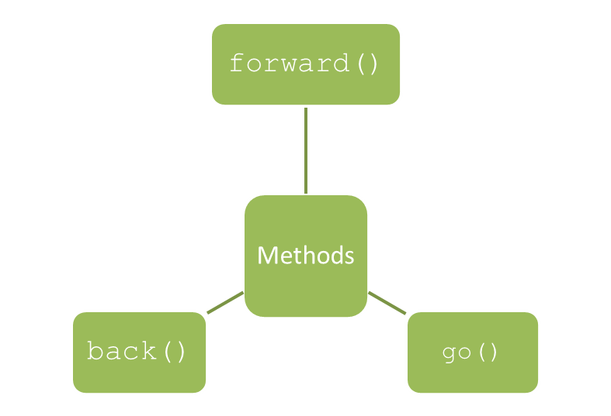
Working with Browser Objects (Contd.)
The history object:
  Contains a list of all the pages that have been visited by the user.
  Provides the property, length, to represent the number of links currently referenced by
  the history object.
  Provides the following methods:
Notes:
x

Slide 5
Working with Browser Objects (Contd.)
The location object:
  Contains information about the current Uniform Resource Locator (URL).
  Enables navigation to different URLs on the Internet.
  Provides the following properties:
  Provides the following methods:
hash
host
hostname
href
port
protocol
assign()
reload()
replace()
Notes:
x

Slide 6
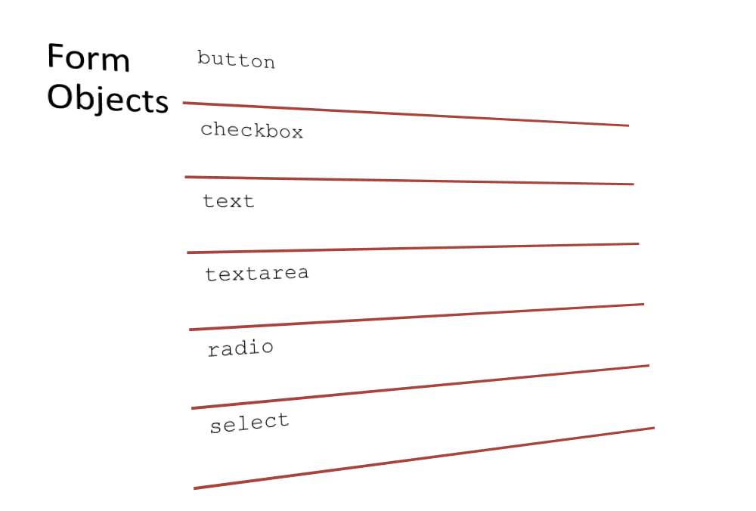
Working with Form Objects
A form object:
  Enables you to create interactive Web pages.
  Acts as a container for the following objects used to collect information from a user:
Notes:
x

Slide 7
Working with Form Objects (Contd.)
The form object:
  Represents a form on the Web page.
  Has the following methods:
    submit()
    reset()
  Has the following event attributes:
    onsubmit
    onreset
Notes:
x

Slide 8
Working with Form Objects (Contd.)
The button object:
  Refers to the HTML button.
  Allows you to perform several tasks based on user actions.
  Has the following methods:
    click()
    focus()
    blur()
  Has the following event attributes:
    onclick
    onmousedown
    onmouseup
Notes:
x

Slide 9

Working with Form Objects (Contd.)
The checkbox object:
  Refers to the HTML check box.
  Has the following methods:
    click()
    focus()
    blur()
  The following embedded Notepad file contains the code that enables you to
  understand the checkbox object:
Notes:
x

Slide 10
Working with Form Objects (Contd.)
The text object:
  Refers to the HTML text box.
  Has the following methods:
    select()
    focus()
    blur()
  Has the following event attributes:
    onfocus
    onchange
    onselect
    The textarea object:
  Refers to the HTML textarea.
  Has similar methods and event attributes as that of the text object.
Notes:
x

Slide 11
Working with Form Objects (Contd.)
The radio object:
  Refers to an HTML radio button.
  Can be referred inside a form using the following syntax:
    document.form1.radio1
Notes:
x

Slide 12
Working with Form Objects (Contd.)
The select object:
  Refers to the HTML drop-down list.
  Has the following methods:
    blur()
    focus()
  Has the following event attributes:
    onchange
    onfocus
    onblur
  Can be referred inside a form using the following syntax:
    document.form1.select1
Notes:
x

Slide 13
Just a Minute
Which one of the following properties specifies the operating system of the
client machine?
  platform
  userAgent
  appCodeName
  appVersion

Slide 14
Just a Minute (Contd.)
Solution:
  platform

Slide 15
Demo: Manipulating the Components of a Web Page
Problem Statement:
  The Online Booking Web page has been created. Now, you want to incorporate the ticket booking functionality on the page according to the following guidelines:
    When the user selects the desired class, the price applicable for the class should be displayed in the Price field.
    When the user specifies the number of tickets, the Total Price field should get populated automatically on the basis of the formula, price * number of tickets.
    Apply a constraint to the Number of Tickets field in such a way that that the user can enter only numeric values in it. In addition, apply validation in such a way that the user is unable to book more than 20 tickets at a time.
    The Date of Bookings field should not accept the date less than the current date.
    The ticket booking confirmation should be displayed only if all the details have been entered by the user.
  Prerequisite: You need to use the ShowOnWheels file that you have created in Activity 5.1 to perform this activity. Ask your faculty to provide you the same.

Slide 16
Demo: Manipulating the Components of a Web Page (Contd.)
Solution:
  To incorporate the ticket booking functionality on the Online Booking Web page, you need to perform the following tasks:
    1. Update the OnlineBooking.html file.
    2. View the form.

Slide 17
Summary
In this session, you learned that:
  The navigator object is used to access information about the current browser.
  The screen object enables you to access details of the user’s screen, such as its width and height.
  The history object contains a list of all the pages that have been visited by the user.
  The location object is used to enable navigation to different URLs on the Internet.
  A form object acts as a container for several objects that collect information from a user.
  A form object can have the following types:
    form
    button
    checkbox
    text
    textarea
    radio
    select

